Slide 1

Resources Group Work
Since PRAGMA 16
Resources Group
Pacific Rim Application and Grid Middleware Assembly
http://www.pragma-grid.net
http://goc.pragma-grid.net

Slide 2
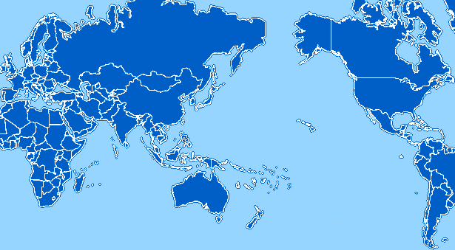
PRAGMA Grid
UZH
Switzerland
UZH
Switzerland
CNIC
China
JLU
China
AIST
OsakaU
UTsukuba
Japan
KISTI
Korea
LZU
China
SDSC
USA
LZU
China
ASGC
NCHC
Taiwan
UPRM
Puerto Rico
CUHK
HKU
HongKong
UoHyd
India
UNAM
Mexico
NECTEC
ThaiGrid
Thailand
HCMUT
HUT
IOIT-Hanoi
IOIT-HCM
Vietnam
CeNAT-ITCR
Costa Rica
UValle
Columbia
MIMOS
USM
Malaysia
IHPC/NGO
NTU
Singapore
MU
Australia
BESTGrid
New Zealand
UChile
Chile
28 institutions in 16 countries/regions, 26 compute sites (+ 4 site in preparation)

Slide 3
PRAGMA Grid
UZH
Switzerland
UZH
Switzerland
CNIC
China
JLU
China
AIST
OsakaU
UTsukuba
Japan
KISTI
Korea
LZU
China
SDSC
USA
LZU
China
More than 5 Year Growth
Many sites upgraded resources
Thinking about new direction
UPRM
Puerto Rico
ASGC
NCHC
Taiwan
CUHK
HKU
HongKong
UoHyd
India
UNAM
Mexico
NECTEC
ThaiGrid
Thailand
HCMUT
HUT
IOIT-Hanoi
IOIT-HCM
Vietnam
CeNAT-ITCR
Costa Rica
UValle
Columbia
MIMOS
USM
Malaysia
IHPC/NGO
NTU
Singapore
MU
Australia
BESTGrid
New Zealand
UChile
Chile
28 institutions in 16 countries/regions, 26 compute sites (+ 4 site in preparation)

Slide 4
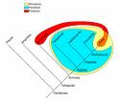
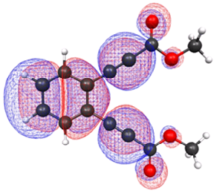
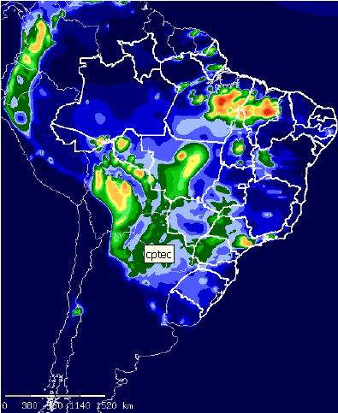
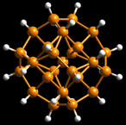
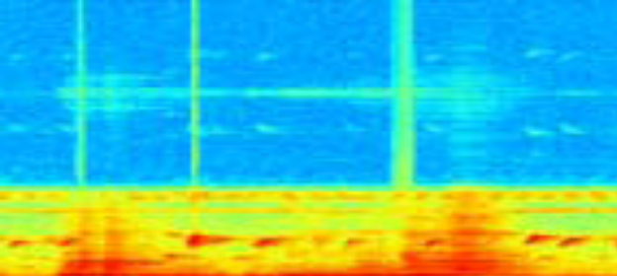
Applications http://goc.pragma-grid.net/wiki/index.php/Applications
17 applications:
  Medical
    DEER (USM, Maylasia), on-going
  Biology
    HMDR (LZU, China), published and completed
  Genomics
    Avian Flu Grid/CSF-Gfarm-Opal-DataTurbine (SDSC/CNIC/JLU/UTsukuba/…), continued
  Fluid dynamics
    e-AIRS (KISTI, Korea), continued
  Ecology
    CSTFT/Ninf-G (UPRM, Puerto Rico), published and completed
  Computer Science
    RIMES (CNIC/UCSD/SDSC)
    Matlab/Nimrod (MU, Australia)
  PRIME
    10 applications in various scientific domains (Students and advisors at UCSD, Monash, Osaka and Hyderabad)
Notes:
DEER = Dengue and Encephalitis Eradication Routines
E-AIRS portal for airodynamics research (CFD codes)
CSTFT
analyzing recording for forest sensors
Cyclic Short Time Fourier Transform
Rimes – NAMB, Dataturbine (molecular dynamics)

Slide 5
Middleware
Rocks virtual cluster (SDSC)
  http://www.rocksclusters.org/roll-documentation/xen/5.2/using-virtual-clusters.html
  Demo with Avian Flu Grid (SDSC, NBCR, AIST, …)
DateTurbine (SDSC)
  http://goc.pragma-grid.net/wiki/index.php/DataTurbine
  Integrations with bio-medical applications, GLEON, CREON
IGTF-PRAGMA combo certificate distribution (BeSTGrid, SDSC)
  http://goc.pragma-grid.net/wiki/index.php/Setup_Certificates_Update
  Setup and tested distribution packages, distribution point and an auto-update procedure
  In operation
VOMS (BeSTGrid, AIST, IHPC, SDSC)
  http://goc.pragma-grid.net/wiki/index.php/VOMRS
  Implemented and tested pool accounts at AIST and SDSC
  Documented all procedures by examples
  Total 4 sites in production
  Tested by users and start setup for GeoGrid application
  1-2 years in the making!

Slide 6
Middleware (continue)
MOGAS-2 (NTU, Singapore)
  http://goc.pragma-grid.net/wiki/index.php/NTU
  Deployed and tested federated databases at SDSC and AIST sites
Gfarm-2
  http://goc.pragma-grid.net/wiki/index.php/Gfarm_Data_Grid
  Released and deployed Gfarm 2.3 at SDSC and AIST
  Applications – GeoGrid and Avian Flu Grid
Gridjobs (UPRM, Puerto Rico)
  http://goc.pragma-grid.net/wiki/index.php/User:Sanabria
  Developed and tested a framework for opportunistic execution in grid environments
  Ready for release
GridWebOS (NCHC, Taiwan)
  http://goc.pragma-grid.net/wiki/images/c/c0/NCHC-update-09.doc
  Developed and tested an user interface to grid computing resources
  Seamless, scalable, easy to use
  In operation at NCHC

Slide 7
Summary
Solid Globus / VOMs infrastructure
Declare Victory!
But, very slow to get here
Challenges
  How can we move faster to provide the next generation of grid resources?
  What is the next generation of grid resources?

